Slide 1
Employee Attrition
A predictive model
Nepanji Davis, Azmir Suljic, Hope Diebold
Notes:
Real world data set solving a real world problem. Helping them achieve their goal of putting together a strategic retention plan.

Slide 2

Why is attrition rate analytics important?
It enables the design of an employee retention model to keep valuable employees engaged and on board.
Company Impacts:
Cost
Attrition
Productivity
Training
Company culture
Employee Value
Performance Rating
Experience & Skills
Satisfaction Metrics

Slide 3

Reducing attrition translates into:
Consistent & higher productivity levels
Significant reduction in direct & indirect costs
Enhanced employee morale
Consistent customer service
Overall increased business performance.

Slide 4
Decision Cycle

Slide 5
Tableau Dashboard

Slide 6

Machine Models and Real World Data
Model used: Random Forest Classifier
Bias- difference btwn observed and predicted; less power and underfit
Variance- difference in performance btwn test and train; high variance = model fits training data well but does not generalize well on test sets
Model Stats
Bias:
Variance:
What does this mean?
Notes:
Challenges
Small data set; n<500
Incomplete dataset
Constant adjustments to roles and responsibilities
Imbalanced data
Predictive model to better understand who would stay with company based on past data.

Slide 7
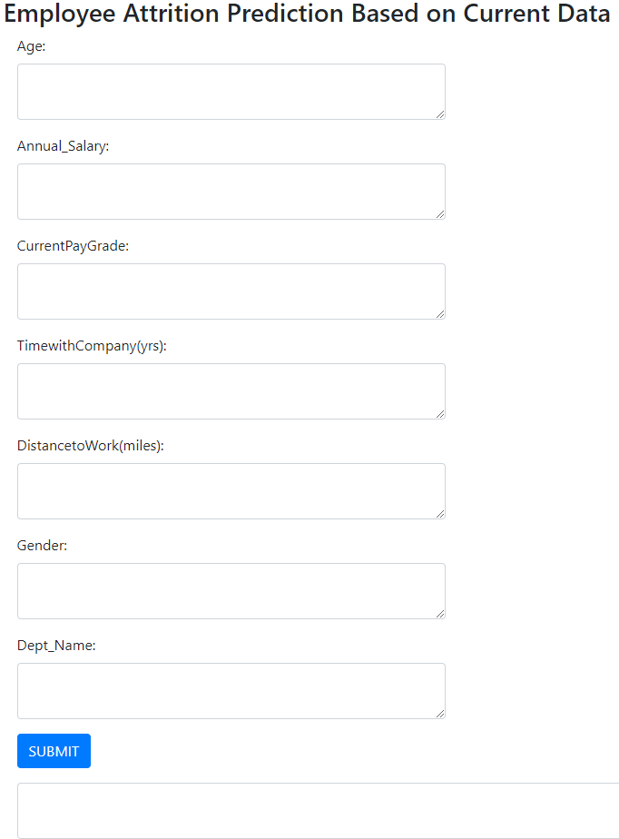
Predictive App

Slide 8

Conclusion: Recommendations to our client
Mandatory collection of reason for leaving code
Minimize number of category and title changes
Create a true succession plan

Slide 9
References
https://learning.linkedin.com/content/dam/me/learning/en-us/pdfs/lil-workbook-calculating-cost-of-employee-attrition-and-disengagement.pdf
https://towardsdatascience.com/breaking-the-curse-of-small-datasets-in-machine-learning-part-1-36f28b0c044d
https://blog.perceptyx.com/employee-attrition-analytics

